Slide 1
(CS2009)-DESIGN AND ANALYSIS OF
ALGORITHMS
Presented By: Sandesh Kumar
Email: sandesh.kumar@nu.edu.pk

Slide 2
LECTURE 7-12 DIVIDE AND CONQUER AND RECURRENCES

Slide 3
DIVIDE AND CONQUER
7 2 ⏐ 9 4 → 2 4 7 9
7 ⏐ 2 → 2 7
9 ⏐ 4 → 4 9
7 → 7
2 → 2
9 → 9
4 → 4

Slide 4
DIVIDE AND CONQUER
Divide and conquer is a general algorithm design paradigm
Divide: divide the input data S in two or more disjoint subsets S1, S2,….
Recur: solve the problems recursively.
Conquer: combine the solutions for S1, S2,…., into a solution for S
The base case for the recursion are sub problems of constant size
Analysis can be done using recurrence equations

Slide 5
MATHEMATICAL RECURRENCES
A recurrence is a function T(n), that is defined in terms of its values with smaller inputs.
⎧
⎪
1 n = 1
Example:
T (n) = ⎨
⎛ n ⎞
⎪2T ⎜ ⎟ + n n > 1
⎪⎩
⎝ 2 ⎠
Usually we drop the base case from the definition.
T (n) = 2T ^{⎛ n ⎞} + Θ(n)
⎜ ₂ ⎟
⎝ ⎠

Slide 6
MATHEMATICAL RECURRENCES
Recurrences are used to represent the runtime of a recursive function
Cost of a recursive algorithm is equal to the cost of non-recursive part plus the recursive call on smaller input size.
We will be spending time looking at recurrences of the form
T (n) = aT^{⎛ n ⎞} + f (n)
⎜ _{b} ⎟
⎝ ⎠
a is the number of times a function calls itself
b is the factor by which the input size is reduced
f(n) is the runtime of each function usually expressed in terms of Θ.

Slide 7
RECURRENCE EXAMPLE
Factorial (n)
{
if (n == 1) return 1;
else
return (n * Factorial(n-1));
}
The expression:
⎧
1
n = 1
T (n) = ⎪
⎨
⎩⎪cT (n −1)+1 n > 1
is a recurrence

Slide 8
RECURRENCE EXAMPLE
Power (n, y)
{
if (y == 0) return 1;
else
return (n * Power(n, y-1));
}
The expression:
⎧
c
n = 0
T (n) = ⎪
⎨
⎪⎩cT (n −1)+1 n > 1
is a recurrence

Slide 9
RECURRENCE EXAMPLE
Power (n, y)
{
if (y == 0) return 1;
else
return (n * Power(n, y-1));
}
The expression:
⎧
c
n = 0
T (n) = ⎪
⎨
⎪⎩cT (n −1)+1 n > 1
is a recurrence

Slide 10
RECURRENCE EXAMPLE
0 n = 0
⎩c + s(n −1) n > 0
0 n = 0
⎩n + s(n −1) n > 0
s(n) = ⎧
s(n) = ⎧
⎨
⎨
⎧
⎪
⎧
⎪
c
n = 1
c
n = 1
T (n) = ⎨
T (n) = ⎪
⎛ n ⎞
⎝ 2 ⎠
⎨
⎪2T ⎜ ⎟ + c
n > 1
⎪
⎛ n ⎞
⎪⎩
⎪aT⎜ _{b} ⎟ + cn
n > 1
⎩
⎝ ⎠

Slide 11
RUNNING TIME OF RECURRENCE EQUATION
Algorithm min1(a[1],a[2],…,a[n]):
If n = = 1, return a[1].
m ← min1(a[1],a[2],…,a[n-1] );
If m > a[n], return a[n], else return m
Now, let’s count the number of comparisons. Steps 1 and 3 will run in constant time Θ(c).
Step 2 will run time recurrence on an input of size n-1
T(n) = T(n -1) + Θ(c); T(1) = 1;

Slide 12
LINEAR SEARCH
LinearSearch ( A, key, low, high)
{
if ( A[low]=key) return low;
else if ( low> high) return (–1)
else LinearSearch(A,key,low+1, high);
}
Note: Key Cost in any search Algorithm is no. of comparisons Recurrence Equation: T(n) = T(n-1) + 1

Slide 13
BINARY SEARCH
BinarySearch(A,low,high,key) if (low >high)
return (–1)
mid ← (low + high)/2
if (key=A[mid])
return mid
else if ( key>A[mid])
BinarySearch(A,mid+1,high,key)
else
BinarySearch(A,low,mid-1,key)
T(n) = T(n/2) + 1, T(1) = 0.

Slide 14
MERGE SORT
Statement
Effort
MergeSort(A, p, r) { if (p < r) {
q = floor((p + r) / 2); MergeSort(A, p, q); MergeSort(A, q+1, r); Merge(A, p, q, r);
}
T(n)
Θ(1)
Θ(1)
T(n/2)
T(n/2)
Θ(n)
}
⎧
⎪
Θ(1)
n = 1
T (n) = ⎨
⎛ n ⎞
⎪2T ⎜ ⎟ + Θ(n) n > 1
⎪⎩
⎝ 2 ⎠
Similarly we have same recurrence equation for Quick Sort

Slide 15
FIBONACCI SEQUENCE
Fib(n)
if ( n<=1)
return n
return (Fib(n-1) + Fib(n-2))
Recurrence Equation:
⎧
Θ(c)
n ≤ 1
T (n) = ⎪
⎨
⎪⎩T (n − 1) + T (n − 2) n > 1

Slide 16
FIBONACCI SEQUENCE
F(n)
What is the drawback in recursive algorithms?
Some problems are computationally too difficult to solve in reasonable period of time. While an effective algorithm exists, we don’t have the time to wait for its completion.
F(n-1)
F(n-2)
F(n-2)
F(n-3)
F(n-3)
F(n-4)
F(0)
F(1)
F(1)
F(0)

Slide 17
TOWERS OF HANOI PUZZLE
Initially:
Three posts (named Left, Middle, Right)
N disks placed in order on the leftmost post
Goal:
Move all the disks on the leftmost post to the rightmost post The original ordering must be preserved
Constraints:
Only one disk may be moved at a time.
Disks may not be set aside but must always be placed on a post. A larger disk may never be placed on top of a smaller disk.

Slide 18
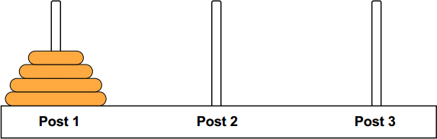
TOWERS OF HANOI PUZZLE
For n = 3, the fastest solution is: Move from Left Post to Right Post
Move from Left Post to Middle Post Move from Right Post to Middle Post Move from Left Post to Right Post Move from Middle Post to Left Post Move from Middle Post to Right Post Move From Left Post to Right Post
The minimum required number of moves is 7.

Slide 19
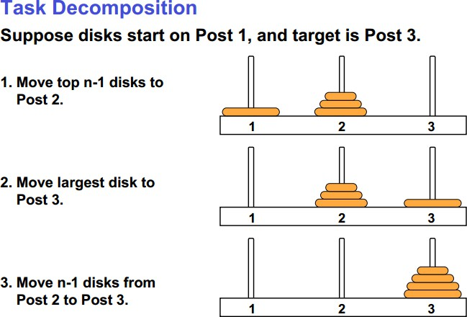
MAKING AN ALGORITHM

Slide 20
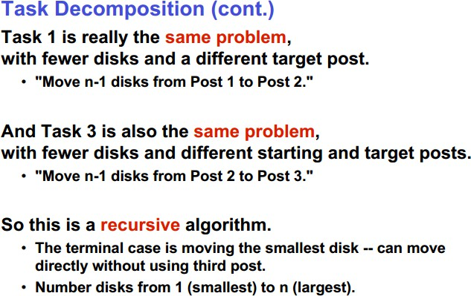
MAKING AN ALGORITHM

Slide 21
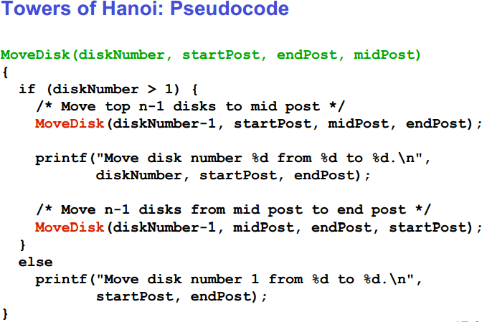
MAKING AN ALGORITHM
⎧
1
n = 1
T (n) = ⎪
⎨
⎪⎩2T (n −1)+1 n > 1

Slide 22
TOWERS OF HANOI PUZZLE
Run-Time Analysis
Disks Required Moves
1 1
2 3
3 7
4 15
5 31
: :
N 𝟐^{𝑵} − 𝟏
2^{n} – 1 ε Big O(2^{n})

Slide 23
SOLVING RECURRENCES
Three methods are used in “solving” recurrences
🢝 The Substitution Method
🢝 The Recursion Tree Method
🢝 The Master Method

Slide 24
SUBSTITUTION METHOD
Substitution method has two steps
Guess the form of the solution
Use induction to prove that the solution is correct
The substitution method can be used to establish an upper bound on difficult
recurrences.
Its use is based on the strength of the guess
applied in cases when it’s easy to guess the form of answer

Slide 25
SUBSTITUTION METHOD
T (n) = 2.T ( ^{n} ) + n
2
n n n
2
T ( ) = 2.T ( 2
₂2
) +
T ( ^{n} ) = 2.T ( ^{n} ) + ^{n}
₂2 ₂3 ₂2
n n n
T (
) = 2.T (
) + ...
₂3 ₂4 ₂3
T ( ^{n} ) = 2.T ( ^{n} ) + ^{n}
₂k −1 ₂k ₂k −1

Slide 26
SUBSTITUTION METHOD
T (n) = 2.T ( ^{n} ) + Θ(n) = 2².T ( ^{n} ) + n + n
₂2
2
T (n) = 2².T ( ^{n} ) + n + n
₂2
T (n) = 2³.T ( ^{n} ) + n + n + n
₂3
...
T (n) = 2^{k}.T ( ^{n} ) + n+––n+ .–..–+n
₂k
k −times
T (n) = 2^{k}.T ( ^{n} ) + k.n
₂k
Let us suppose that : n = 2^{k} ⇒ log n = k
2
Hence,T (n) = n.T (1) + n.log₂ n = n + n.log₂ n
T (n) = Θ(n.log₂ n)

Slide 27
SUBSTITUTION METHOD
T (n) = 2.T ( ^{n} ) + Θ(n) = 2².T ( ^{n} ) + n + n
₂2
2
T (n) = 2².T ( ^{n} ) + n + n
₂2
T (n) = 2³.T ( ^{n} ) + n + n + n
₂3
...
T (n) = 2^{k}.T ( ^{n} ) + n+––n+ .–..–+n
₂k
k −times
T (n) = 2^{k}.T ( ^{n} ) + k.n
₂k
Let us suppose that : n = 2^{k} ⇒ log n = k
2
Hence,T (n) = n.T (1) + n.log₂ n = n + n.log₂ n
T (n) = Θ(n.log₂ n)

Slide 28
SUBSTITUTION METHOD
Quick Sort Worst case: pivot is smallest/largest element all the time. T(n) = T(n-1) + cn
T(n-1) = T(n-2) + c(n-1)
T(n-2) = T(n-3) + c(n-2)
…
T(n-k) = T(n-k-1) + c(n-k)
Let us suppose that : n − k = 1 ⇒ k = n −1
n
T(n) = T(1) + c ∑i = O(n² )
i=1
T(n) = T(n-1) + cn ➔ T(n) = T(n-2) + c(n-1) + cn
T(n) = T(n-3) + c(n-2) + c(n-1) + cn ➔ T(n) = T(n-k) + c(n + n-1 + … n-k)

Slide 29
SUBSTITUTION METHOD
Solve the recurrence relation given below.
⎧1
if n = 1
otherwise
T (n) = ⎪
⎨ n
⎪3⋅T ( ₄ ) + n
⎩
Solution:
(1) T (n) = 3 ⋅ T ( ^{n} ) + n
4
n n
n
4
(2) T ( ) = 3⋅T (
₄2
) +
4
(3) T ( ^{n} ) = 3 ⋅ T ( ^{n} ) + ^{n}
₄2 ₄3 ₄2
and soon
(4) T ( ^{n} ) = 3⋅T ( ^{n} ) + ^{n}
₄k −1 ₄k ₄k −1

Slide 30
SUBSTITUTION METHOD
n
Now substitute the value of T ( ) from (2) to (1)
4
(5) T (n) = 3⎡3T ( ^{n} ) + ^{n ⎤} + n
₄2
⎢_{⎣ 4} ⎥⎦
= 3² ⋅ T ( ^{n} ) + ( ³) ⋅ n + n
₄2
4
substitutethe value of T ( ^{n} ) from(3) to (5) equation, we have
₄2
T (n) = 3^{2 ⎡}3 ⋅T ( ^{n} ) + ^{n ⎤} + ( ³)n + n
⎢⎣
₄3 ₄2 ⎥⎦
4
3
0
T (n) = 3^{k} ⋅T ( ^{n} ) + ( ³)^{k −1} n + ( ³)^{k −2} + ⋅⋅⋅⋅ +( ³)n + ( ) n
4 4 4 4
₄k
Let us suppose that : n = 4^{k} ⇒ log n = k
4
n ₊ 3
k −1 ⎤
⎥⎦
T (n) = 3^{k} ⋅T ( ) + n⎡1+ ³
n
( ) ( )² +.... + ( ³)
4 4 4
⎢⎣

Slide 31
SUBSTITUTION METHOD
n
₊ 3
k −1 ⎤
⎥⎦
T (n) = 3^{k} ⋅T ( ) + n⎡1+ ³
n
( ) ( )² +.... + ( ³)
4 4 4
⎢⎣
⎡
3
⎤
⎢
1 − ( )
k
⎥
1 − x^{k}
T (n) = 3^{k} ⋅ T (1) + n⎢1⋅ ( ⁴ )⎥ 1 + x + x ²
+ ... + x^{k −1} = 1⋅ (
)
⎢
1 − ³
4
⎥
1 − x
⎢⎣
⎥⎦
) T (1) = 1
₃k
k
T (n) = 3 ⋅1 + 4n(1 −
₄k
₃k
₃k
n − 3^{k}
k
T (n) = 3^{k} + 4n ⋅ (1−
) = 3^{k} + 4n ⋅ (1− )
= 3 + 4n(
)
₄k
n
n
= 3^{k} + 4(n − 3^{k} )
= 4 ⋅ n − 3 ⋅ 3^{k}
3
= 1⋅ 3^{k} + 4n − 4 ⋅ 3^{k}
= 4n − 3 ⋅ 3
log
n
4
T (n) = 4n − 3⋅ n
log
4
Hence T (n) ∈θ (n)

Slide 32
SUBSTITUTION METHOD – A HARD EXAMPLE
⎧1 if n = 1
T (n) = ⎪
where 0 < a < b
n
⎨aT ( ) + n
otherwise
⎪⎩
b
_{Solution:} T (n) = aT ( ^{n} ) + n
= a ⋅ a ⋅T ( ^{n} ) + a ⋅ ^{n} + n
b
_{b}2
b
= a ² ⋅ T ( ^{n} ) + ( ª )n + n
= a^{2 ⎡}aT( ^{n} ) + ^{n ⎤} + ( ª )n + n
b
_{b} 2
b
⎢⎣
_{b}3 _{b}2 ⎥⎦
= a ³T ( ^{n} ) + ( ª )² n + ( ª )n + n
_{b}3
b b
k −1 _{n +} ª
a
T (n) = a^{k} T ( ^{n} ) + ( ª )
b
1
_{b}k
( )^{k −2} n + .... + ( ) n + n b b
₊ a
k −1 ⎤
⎥⎦
= a^{k} T ( ^{n} ) + n⎡1+ ª
2
_{b}k
⎢⎣
( ) ( ) + .... + ( ª )
b b b

Slide 33
SUBSTITUTION METHOD – A HARD EXAMPLE
k −1 ⎤
⎥⎦
T (n) = a^{k} ⋅T (1) + n⎡1+ ( ª ) +.... + ( ª )
b
⎢⎣
b
Let us suppose that, n = b^{k}
⎡
a
_{k} ⎤
⎢1 − ( ) ⎥
b a
k
k
= a^{k} T (1) + n⎢ ^{b} ⎥
= a ⋅T (1) + n(
)(1− )
_{b}k
⎥
b − a
⎢ 1 − ª
⎢⎣
b
⎥⎦
_{b}k
_{b}k
b
− a^{k}
b
− a^{k}
k
k
_{b}k
b
= a + n(
)( )
= a ⋅1 + n(
)(
)
b − a
b − a n
b
b
₊ ₍b − a − b _{)ak}
= a^{k} +
⋅ b^{k} −
⋅ a^{k}
=
⋅ b^{k}
b − a
b − a
a
b − a
b − a
b
b
a
T (n) = (
) ⋅ b^{k} −
⋅ a
log
n b
=
⋅ n −
⋅ n
log
a b
b − a
b − a
b − a
b − a
⇒ T (n) ∈θ (n)

Slide 34
SUBSTITUTION METHOD – A MORE HARD
EXAMPLE
⎧1 if n = 1
T (n) = ⎪
⎨ n
⎪3 ⋅ T ( ₄) + cn
2
otherwise
⎩
Solution:
(1) T (n) = 3 ⋅ T ( ^{n} ) + cn ²
4
n n
n
(2) T ( ) = 3 ⋅ T ( ) + c( )
4 4
2
₄2
(3) T ( ^{n} ) = 3 ⋅ T ( ^{n} ) + c( ^{n} )²
₄2 ₄3 ₄2
(4) T ( ^{n} ) = 3 ⋅ T ( ^{n} ) + c( ^{n} )²
₄3 ₄4 ₄3
and soon
(5) T ( ^{n} ) = 3⋅T ( ^{n} ) + c( ^{n} )²
₄k −1 ₄k ₄k −1

Slide 35
SUBSTITUTION METHOD – A MORE HARD
EXAMPLE
n
Now substitute the value of T ( ) from(2) to (1)
4
(6) T (n) = 3⎡3T ( ^{n} ) + c( ^{n})^{2 ⎤} + cn ²
= 3² T ( ^{n} ) + 3c( ^{n})² + cn ²
⎢⎣
₄2
4
⎥⎦
₄2
4
substitutethe value of T ( ^{n} ) from(3) to (6), we have
₄2
T (n) = 3^{2 ⎡}3T ( ^{n} ) + c( ^{n} )^{2 ⎤} + 3c ⋅ ( ^{n})² + cn ²
₄3 ₄2
⎢⎣ ⎥⎦
4
= 3³ T ( ^{n} ) + 3² c( ^{n} )² + 3c ⋅ ( ^{n} )² + cn ²
₄3 ₄2
4
= 3³ T ( ^{n} ) + ( ³ )² cn ² + ( ³ )¹ cn ²
₄3 ₄2 ₄2
+ cn ²
T (n) = 3^{k} T ( ^{n} ) + ⎡( ³ )^{k −1}
₄k ⎢_{⎣ 4}2
₊ ₍ ³ ₎k −2
+ ⋅ ⋅ ⋅ ⋅ +( ³ )^{0 ⎤}cn ²
₄2
₄2
⎥⎦

Slide 36
SUBSTITUTION METHOD – A MORE HARD
EXAMPLE
Let us suppose that n can be expressedas n = 4^{k}
k −1 ⎤
⎥⎦
T (n) = 3^{k} T (1) + cn ^{2 ⎡}1 + ³ + ( ³ )² + ⋅ ⋅ ⋅ ⋅ + ³
⎢⎣
16 16
⎤
( )
16
⎡ 1 − ( ³ )^{k}
₃k
⎢
⎥
16
k
2
13 16
T (n) = 3^{k} ⋅1 + cn ² ⎢( ¹⁶ )⎥
= 3 + cn
⋅ (1 −
)
k
⎢
1 − ³
⎥
⎢⎣
16
⎥⎦
⇒ (4² )^{k} = n²
since
₄k
= n ⇒ (4^{k} )² = n²
⇒ 16^{k} = n ²
= ¹⁶ c ⋅ n² + (1 − ¹⁶ c)3^{k}
13 13
2
= 3^{k} + cn ² ⋅ ¹⁶ ( ^{n}
− 3^{k}
= 3^{k} + ¹⁶ ⋅ c ⋅ (n² − 3^{k} )
_{n}2
)
13
13
16
n
4
T (n) = ¹⁶ cn ² + (1 − c)3
log
= ¹⁶ cn² + (1− ¹⁶ c)n^{log}4³
13 13
T (n) ∈θ (n² )
13
13
Hence

Slide 37
RECURSION TREE METHOD
Although substitution method can provide a sufficient proof that a solution to a recurrence is correct, sometimes difficult to give a good guess.
Draw a recursion tree
straight forward way to devise a good guess.
In recursion tree, nodes represent costs of a sub-problems in the set of recursive function invocations.
Sum up processing done at each level of the tree
Then sum all per-level costs to determine the total cost of all levels of the recursion.
Useful when recurrence describes running time of divide and conquer algorithms.

Slide 38
RECURSION TREE METHOD
Using recursion tree to generate a good guess, we can often tolerate a small amount of sloppiness since we have to verify it later on.
If we are careful when drawing out a recursion tree and summing costs, then we can use a recursion tree as a direct proof of a solution to any recurrence of any problem.

Slide 39
RECURSION TREE METHOD
Example:
Solve the following recurrence using recurrence tree method
⎧Θ(1) if n = 1
T (n) = ⎪
⎨
n
2
⎪3.T ( ) + Θ(n ) if otherwise
Solution: The above recurr⎩ence⁴can be written in the form
⎧ ₁
if n = 1
if otherwise
T (n) = ⎪
⎨
n
⎪ 3.T ( ) + cn
2
⎩ 4
Assumption: We assume that n is exact power of 4. The recurrence tree is given in the next slide

Slide 40
RECURSION TREE METHOD
c.n²
T(n) = 3.T(n/4)+c.n²
T(n/4)
T(n/4)
T(n/4)
c.n²
c.(n/4)²
c.(n/4)²
c.(n/4)²
T(n/16) T(n/16) T(n/16)
T(n/16) T(n/16)
T(n/16)
T(n/16) T(n/16) T(n/16)

Slide 41
RECURSION TREE METHOD
c.n²
c.n²
Suppose n=4^{k}
c.(n/4)²
c.(n/4)²
c.(n/4)²
(3/16).c.n²
c(n/16)² c(n/16)²
c(n/16)²
c(n/16)²
c(n/16)² c(n/16)² c(n/16)²
c(n/16)²
c(n/16)²
(3/16)².c.n²
T(n/4^{k})
T(n/4^{k}) T(n/4^{k})
T(n/4^{k}) T(n/4^{k})
T(n/4^{k}) T(n/4^{k})
T(n/4^{k})

Slide 42
RECURSION TREE METHOD
c.n²
c.n²
Suppose n = 4^{k}
c.(n/4)²
c.(n/4)²
c.(n/4)²
(3/16).c.n²
c(n/16)² c(n/16)²
c(n/16)²
c(n/16)²
c(n/16)² c(n/16)² c(n/16)² c(n/16)²
c(n/16)²
(3/16)².c.n²
(3/4²)^{k-1} cn²
T(n/4^{k})
T(n/4^{k}) T(n/4^{k})
T(n/4^{k}) T(n/4^{k})
T(n/4^{k}) T(n/4^{k})
T(n/4^{k})
T(1) T(1) T(1) T(1) T(1) T(1) T(1) T(1) T(1) T(1) T(1) T(1)

Slide 43
RECURSION TREE METHOD
Total computation cost = Cost of Children + Cost of tree excluding children
= Cost of Child x total number of Children + Cost of all levels excluding children level
= total number of Children + sum of costs at each level excluding children level.
₄k
= n ⇒ k = log n
log
n
4
4
T (n) = 3 + cost at Levels above child level
T (n) = Θ(n^{log4} ) + ⎡( ³ )⁰ + ( ³ )¹ +⋅⋅⋅⋅+( ³ )^{k −1 ⎤}cn²
3
⎢_{⎣ 4}2 ₄2 ₄2
⎥⎦
1
T (n) ≤ Θ(n^{log4 3} ) + (
)cn² = Θ(n^{log4 3} ) + ¹⁶ cn²
3
13
Hence : T (n) = Ο(n² )
1− ( )
16

Slide 44
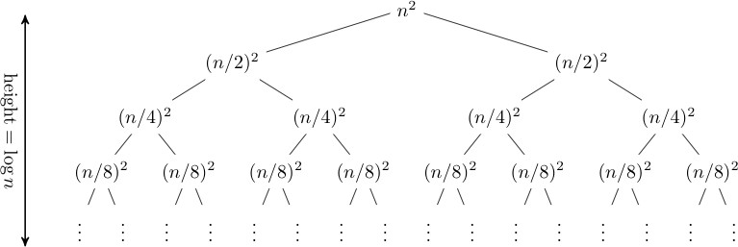
RECURSION TREE METHOD
T(n) = 2T(n/2) + n²

Slide 45
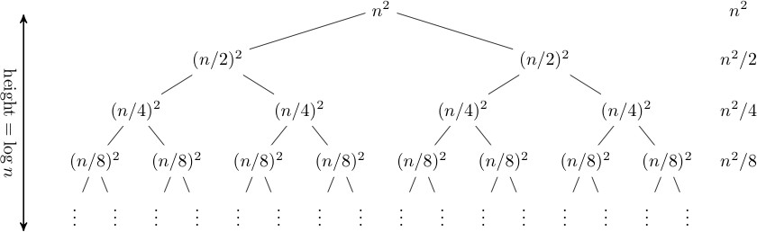
RECURSION TREE METHOD

Slide 46
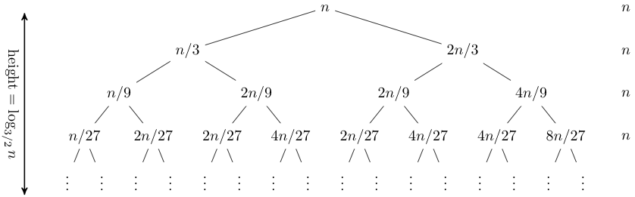
RECURSION TREE METHOD
T(n) = T(n/3) + T(2n/3) + n.

Slide 47
RECURSION TREE METHOD
Solve T(n) = T(n/4) + T(n/2) + n²:

Slide 48
RECURSION TREE METHOD
Solve T(n) = T(n/4) + T(n/2) + n²:
T(n)

Slide 49
RECURSION TREE METHOD
Solve T(n) = T(n/4) + T(n/2) + n²:
_{n}2
T(n/4)
T(n/2)

Slide 50
RECURSION TREE METHOD
Solve T(n) = T(n/4) + T(n/2) + n²:
_{n}2
(n/4)²
(n/2)²
T(n/16)
T(n/8)
T(n/8)
T(n/4)

Slide 51
RECURSION TREE METHOD
Solve T(n) = T(n/4) + T(n/2) + n²:
_{n}2
(n/4)²
(n/2)²
(n/16)²
(n/8)²
(n/8)²
(n/4)²
Θ(1)

Slide 52
RECURSION TREE METHOD
Solve T(n) = T(n/4) + T(n/2) + n²:
_{n}2
(n/4)²
(n/2)²
(n/16)²
(n/8)²
(n/8)²
(n/4)²
Θ(1)

Slide 53
RECURSION TREE METHOD
Solve T(n) = T(n/4) + T(n/2) + n²:
_{n}2
_{n}2
(n/4)²
(n/2)²
(n/16)²
(n/8)²
(n/8)²
(n/4)²
Θ(1)

Slide 54
RECURSION TREE METHOD
Solve T(n) = T(n/4) + T(n/2) + n²:
_{n}2
_{n}2
(n/4)²
(n/2)²
(n/16)²
(n/8)²
(n/8)²
(n/4)²
Θ(1)

Slide 55
RECURSION TREE METHOD
Solve T(n) = T(n/4) + T(n/2) + n²:
_{n}2
_{n}2
5 _{n2}
(n/4)²
(n/2)²
16
(n/16)²
(n/8)²
(n/8)²
(n/4)²
Θ(1)

Slide 56
RECURSION TREE METHOD
Solve T(n) = T(n/4) + T(n/2) + n²:
_{n}2
_{n}2
5 _{n2}
(n/4)²
(n/2)²
16
25 _{n2}
(n/16)²
(n/8)²
(n/8)²
(n/4)²
256
…
Θ(1)

Slide 57
RECURSION TREE METHOD
Solve T(n) = T(n/4) + T(n/2) + n²:
_{n}2
_{n}2
5 _{n2}
(n/4)²
(n/2)²
16
25 _{n2}
(n/16)²
(n/8)²
(n/8)²
(n/4)²
256
…
n (1 + + ( ) + ( ) )
Θ(1)
2
2 3
5
16 16 16
Total =
5
5
+☹
= Θ(n²)
geometric series

Slide 58
MASTER METHOD
The master theorem is a formula for solving recurrences of the form T(n) = aT(n/b) + f(n), where a ≥ 1 and b > 1 and f(n) is asymptotically positive. (Asymptotically positive means that the function is positive for all sufficiently large n.)
This recurrence describes an algorithm that divides a problem of size n into a subproblems, each of size n/b, and solves them recursively

Slide 59
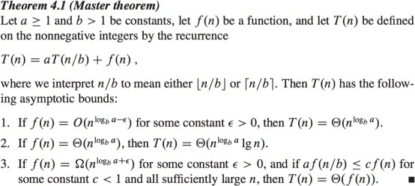
MASTER METHOD
The theorem is as follows:

Slide 60
PRACTICE QUESTIONS
T (n) = 3T (n/2)+ n²
T (n) = 4T (n/2)+ n
T (n) = T (n/2) + 2n
T (n) = T (n/2) + 1
T (n) = 2nT (n/2) + n
T (n) = 16T (n/4)+ n
T (n) = 2T (n/2)+ n log n
T (n) = 2T (n/4)+ n0.51

Slide 61
PRACTICE QUESTIONS
T (n) = 3T (n/2)+ n
T (n) = 3T (n/3)+ pn
T (n) = 4T (n/2)+ cn
T (n) = 3T (n/4)+ n log n
T (n) = 3T (n/3)+ n/2
T (n) = 6T (n/3)+ n² log n
T (n) = 4T (n/2)+ n/ log n
T (n) = 64T (n/8)− n² log n
T (n) = 0.5T (n/2)+ 1/n

Slide 62
PRACTICE QUESTIONS
T (n) = 7T (n/3)+ n²
T (n) = 4T (n/2)+ log n
T(n)=2T(n-1)+O(n)
T(n) =3T(n/3) + O(n)

